Slide 1
IT54-24
The Assignment
Team Member
1. Mr. Panawut Ittitananun 54216952
2. Mr. Nitiwit Wungwiwatna 54216937
3. Mr. Thanakit Mahamutjinda 54216924
Advisor
1. Aj. Kittiphan Puapholthep
2. Aj. Unhawa Ninrutsirikun

Slide 2




Project Information
Main Features
Type of users
Create Assignment
Do / Send Assignment
Check Assignment
Check Copy
Auto approve
Web Application
Teacher
Student
Mobile Application

Slide 3
Use Case Diagram
Class Diagram
What in our presentation
Key features
Prototype & Mockup

Slide 4
Use Case Diagram
What in our presentation

Slide 5
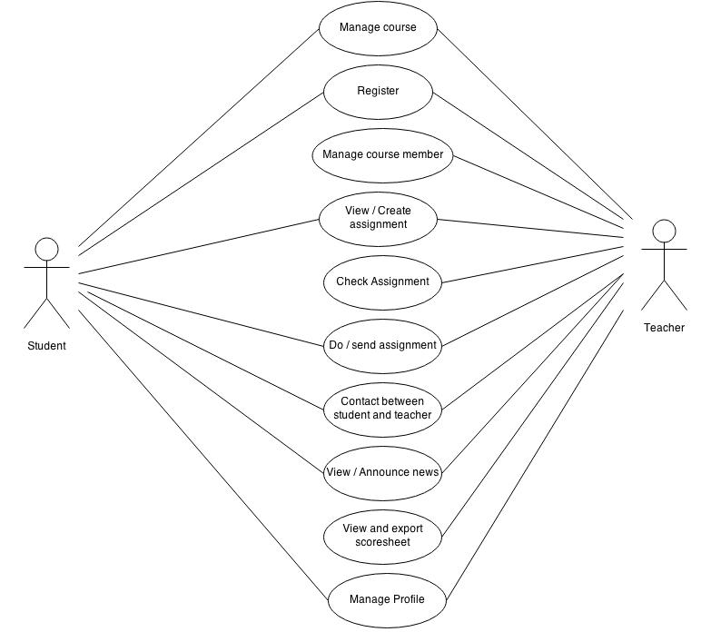
Web Application

Slide 6
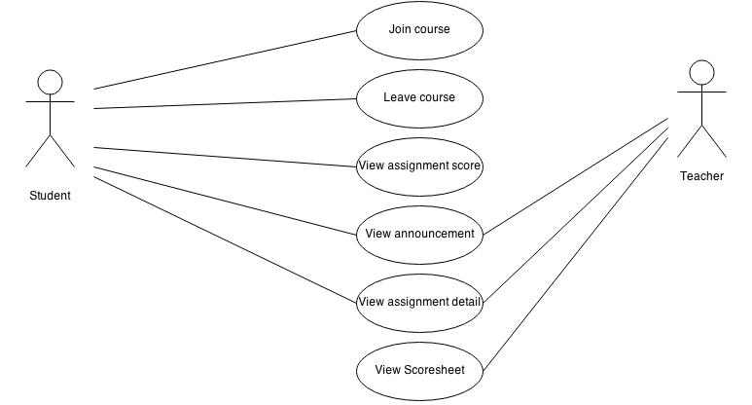
Mobile Application

Slide 7
Class Diagram
What in our presentation

Slide 8
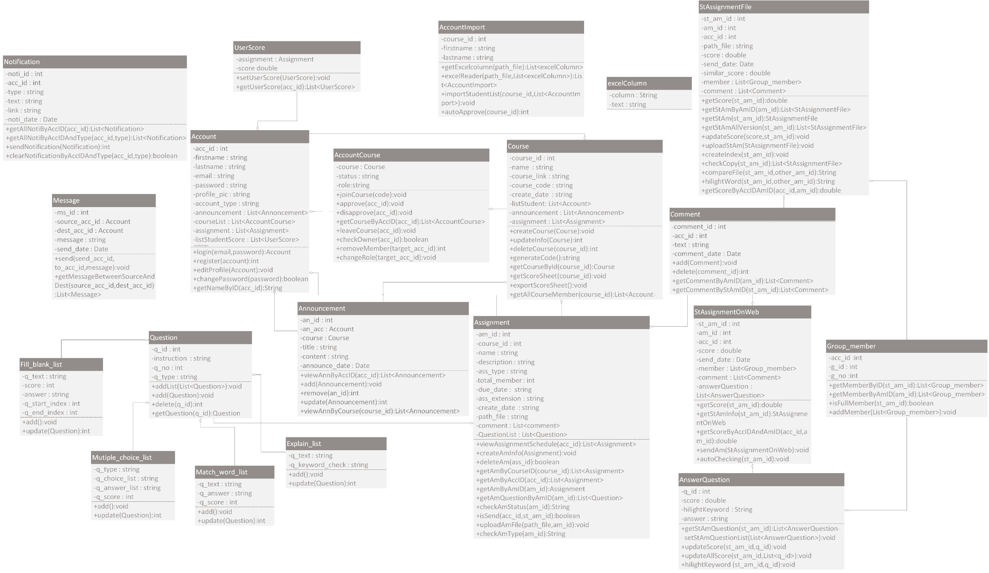
Class Diagram

Slide 9
Key features
What in our presentation

Slide 10
Key feature
Create assignment
Do and send assignment
Check assignment

Slide 11
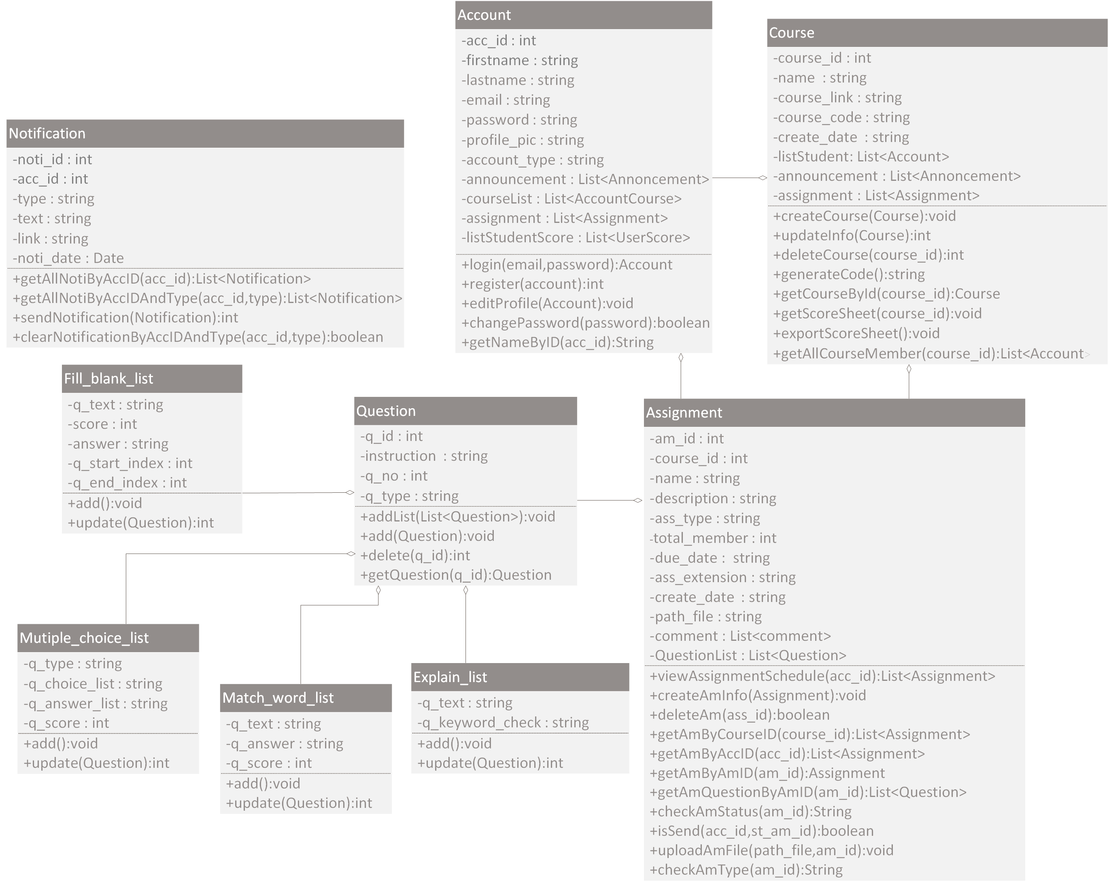
Create Assignment
Notes:
In the first key features, create assignment. This feature has 5 related class.
account class. This class use for authentication user and keeping information such as name , surname , email , password and user type must be teacher only.
Course class , this class diagram used to connect course that teacher want to create assignment
Assignment class. It is a class that keep assignment details like name, send date and type of assignments files or do on web. If you create assignment that is doing on web, it will keep additional groups of questions.
Next we have have 4 types, fill in the blank , multiple choice , match the word and explanation questions. Therefore, all types of questions must keep extend question class.
- And we have notification class for notify many events
In the create assignment sequence diagram
we start with sign in and enter in your course that you are teacher. When you enter into the course. System will retrieve the data of course and keep it in the session for using in many functions.
Next we must click on assignment menu and then system will retrieve assignment data in the course to show on the page.
In the assignment page we can see create assignment button. When you click create assignment button you will see page for create assignment and we have 3 step for create. First is enter the assignment information, second is upload the assignment file . Finally is preview that assignment and submit the assignment
If you want to create assignment in type of doing on web. You need to send to list of question and score to the system.
After all process finished It will notify to student
I will tell you for more information in prototype

Slide 12
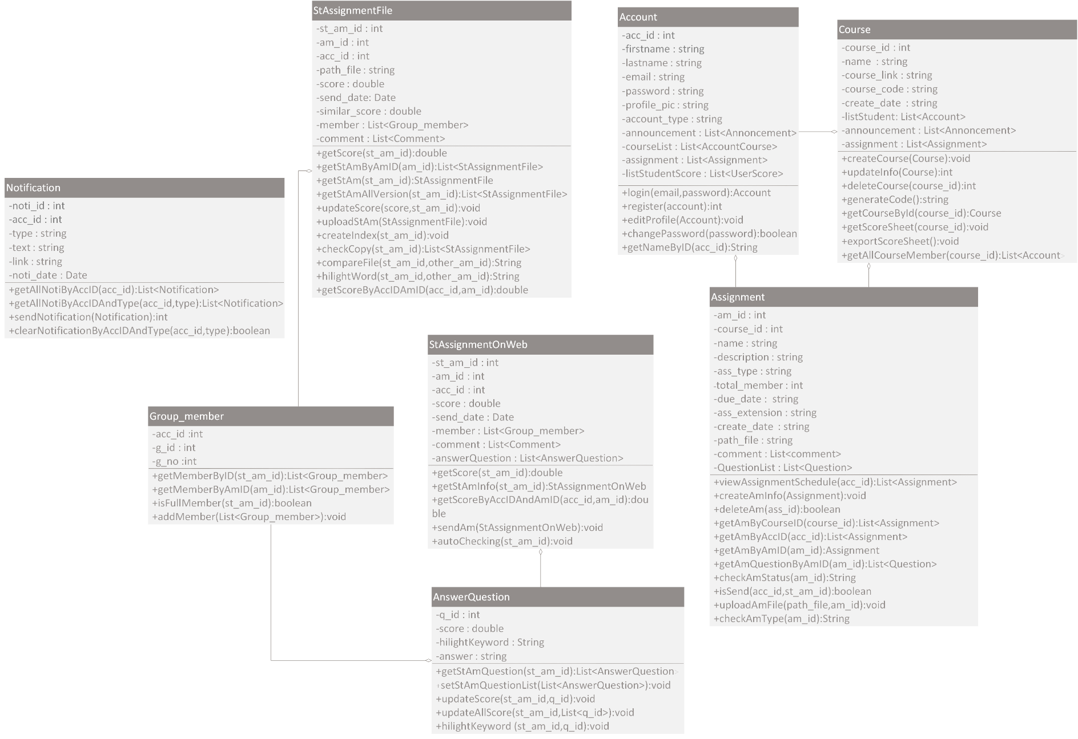
Do / Send Assignment
Notes:
Second, Do / Send Assignment feature
We must add more class than account course and assignment class, that is
StAssignmentFile. This class use for keeping sent assignment details in type of files. It’ll keep files directory , members and comments in assignments.
Second, StAssignmentOnWeb class. This class keeps assignment details in type of doing on web. The details have members of assignments and groups of students answers that use to check score.
In the sequence diagram of do and send assignment
- When we sign in and select assignment menu It will show all assignment
- Next, you select assignment that you want to do. A system will check member in a group first. If you have not group. You must select your group member before you working or you can select member manually before you enter in the assignment
- When you get it assignment page If that assignment is sending with file you must upload assignment to the system. In the other hand. If that assignment is doing on web. You must answer the question on the web and submit it for send

Slide 13
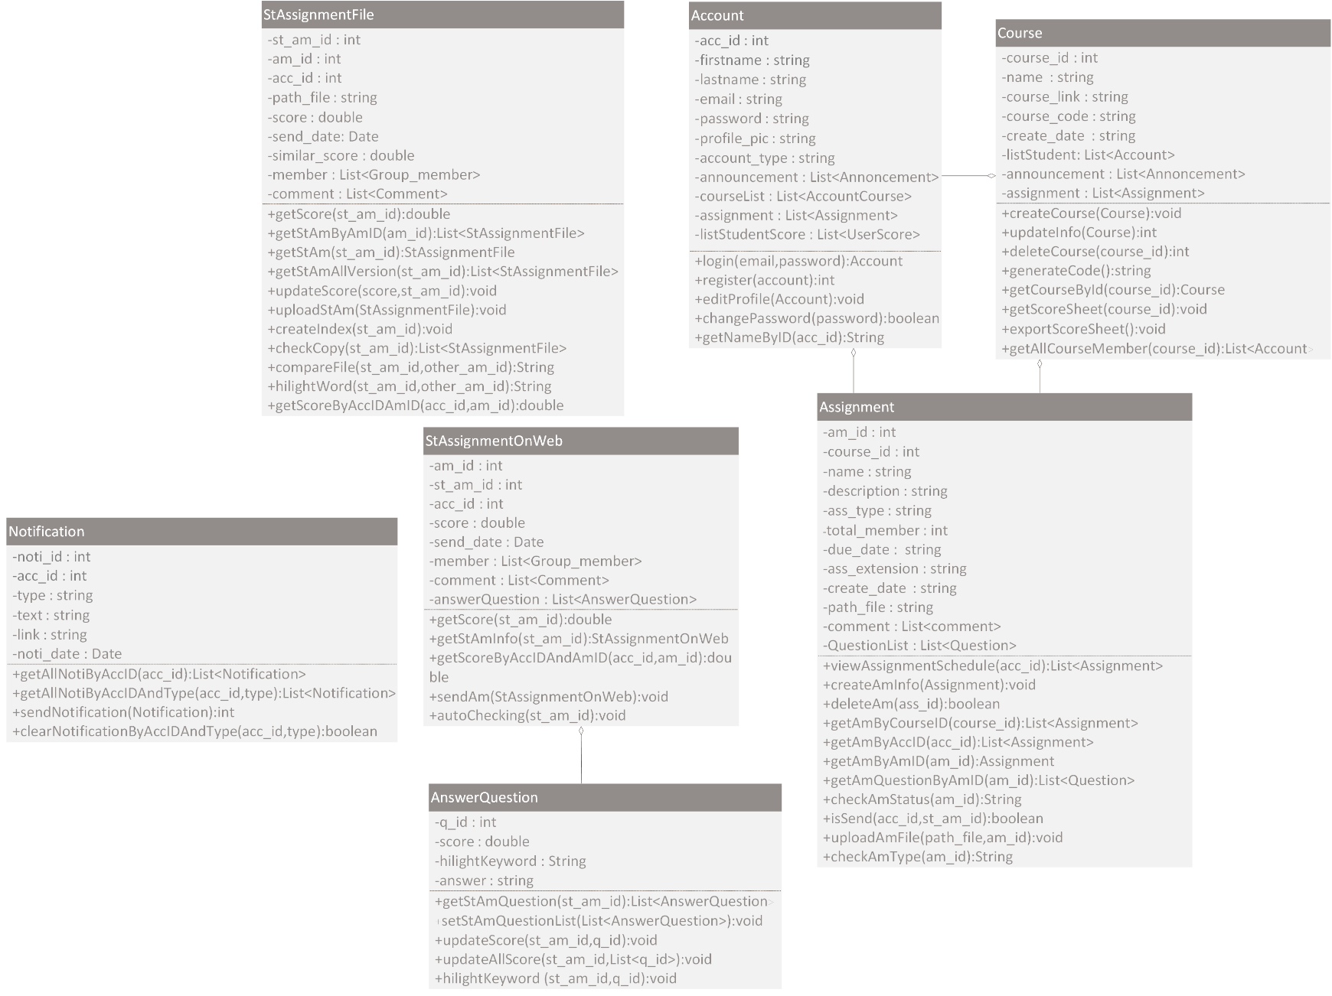
Check Assignment
Notes:
Last key feature is Check assignment
We have classes that used for checking assignment like do and send assignment. We use StAssignmentFile class to keep student assignment score and StAssignmentOnWeb class will keep list of questions that used for checking answer of assignment and keep total score of all of the questions.
Next, I will describe about sequence diagram of check assignment.
When student send assignment into the system.
If that assignment is a type of file.
System will notify to teacher to let him come to check it.
But if that assignment is type of doing on web.
When student send the assignment.
System will check assignment and give score automatically and system will notify to teacher.
The system won’t show assignment score to student immediately
because teacher must come to check it again for checking correction of score and change the assignment status to don’t let student come to edit it again.
After that , it will notify to student about assignment score.

Slide 14
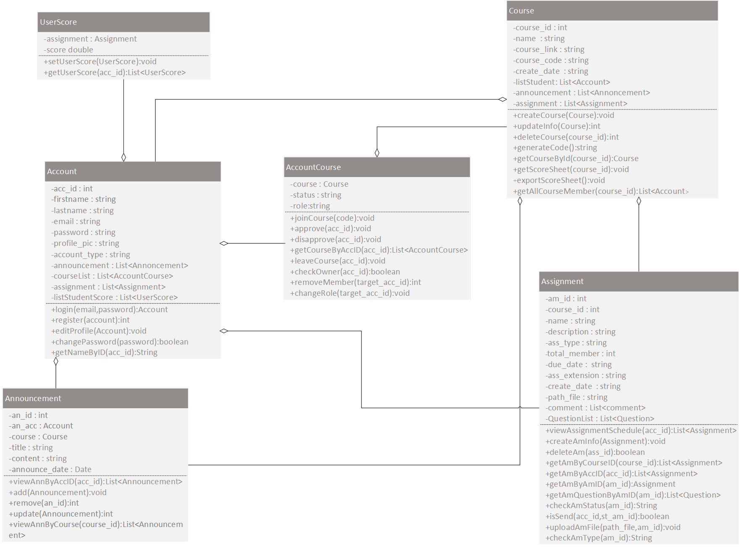
Class Diagram of Account and course
Notes:
ต่อไปจะเป็นคลาสที่แสดงความสัมพันธ์ระหว่างตัว account กับ course
จากรูป class account จะประกอบไปด้วยรายละเอียดทั่วไปของ account เช่น ชื่อ นามสกุล email password และข้อมูลที่เกี่ยวข้องในด้านต่างๆเช่น มี anncouement อะไรบ้างที่ได้รับ มีคะแนนของการบ้านทุกๆชิ้น มีรายชื่อของคอร์สที่ account นั้นอยู่ และที่สำคัญมีการบ้านทั้งหมดที่ account นั้นได้รับ
Class ที่สำคัญที่ Class คือ Class course Class นี่จะประกอบไปด้วย รายละเอียดของคอร์สเช่น ชื่อ ,รหัสที่ใช้ในการ join และข้อมูลที่เกี่ยวข้องต่างๆ เช่น รายชื่อนักเรียนทั้งหมดในคอร์ส การบ้านทั้งหมดในคอร์ส และประกาศทั้งหมดของคอร์ส
This is class diagram that tell you about relationship between account and course.
As you can see from the picture, account class has general information of account such as name , surname , email , password and specific information like received announcement , assignment’s scores , course names and all assignment in the account.
Class that is important is course class. It has course detail such as course name, course code for joining and specific information like list of student names , assignments and announcements in the course

Slide 15
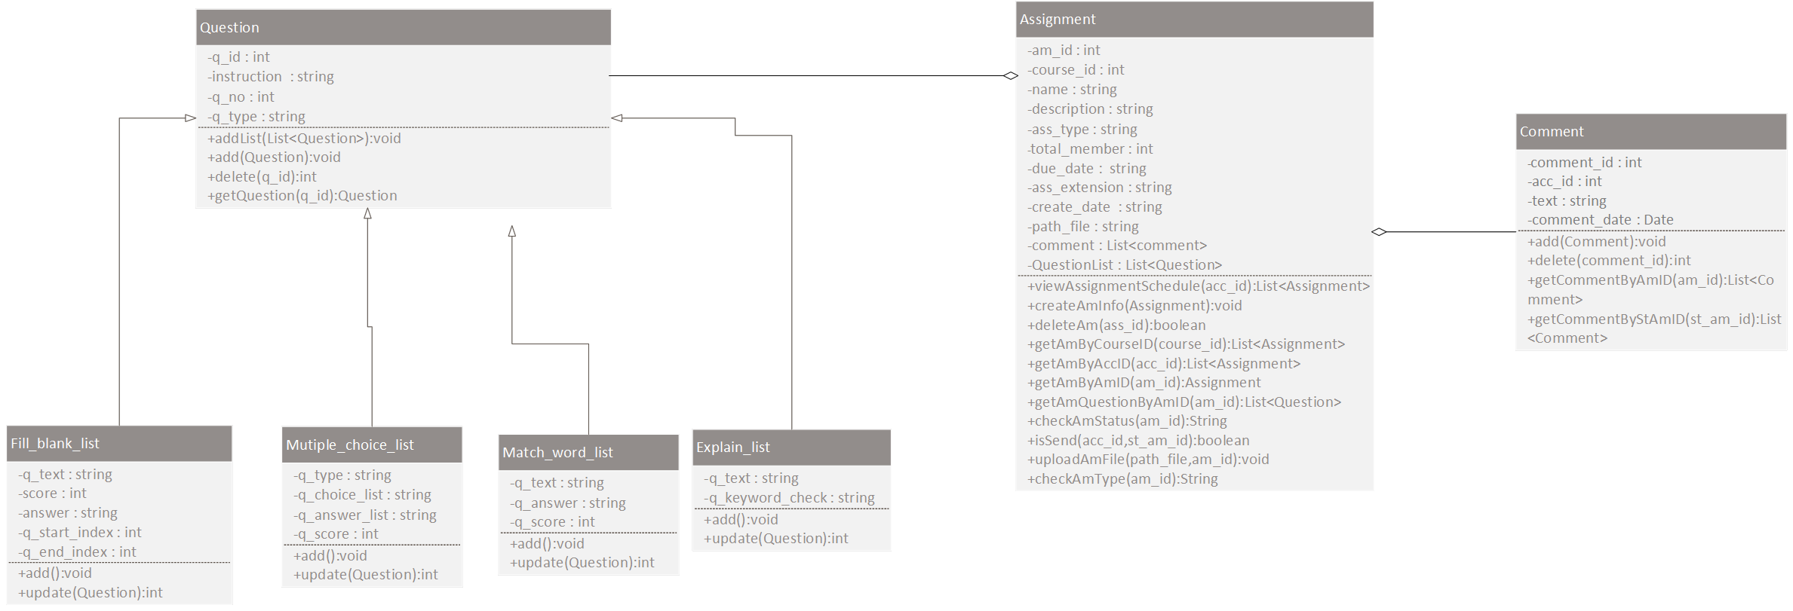
Class Diagram of Assignment
Notes:
ต่อมา class หลักๆ อีกอย่างนึงคือ assignment ซึ่งเป็น class ที่เก็บรายละเอียดของ assignment ไม่ว่าจะเป็น ชื่องาน ประเภทของงานว่าส่งเป็นไฟล์หรือทำบนเว็บ วันที่ต้องส่ง รวมไปถึงชุดของ comment ที่มีการถามตอบกันในงาน
และหากงานนั้นเป็นการประเภท ทำบนเว็บ จะเก็บชุดของคำถามเพิ่มเติมด้วย โดยแบ่งคำถามเป็น 4 ประเภทคือ fill in the blank,multiple choice, match the word and explaination question ซึ่ง คำถามในแต่ละประเภทจำเป็นจะต้อง extend class question ด้วย
Next is, assignment class. It is a class that keep assignment details like name, type of assignments files or do on web , send date and comment in the assignment. If that assignment is doing on web, it will keep groups of questions. The questions have 4 types, fill in the blank , multiple choice , match the word and explanation questions. Therefore, all types of questions must keep extend question class.

Slide 16
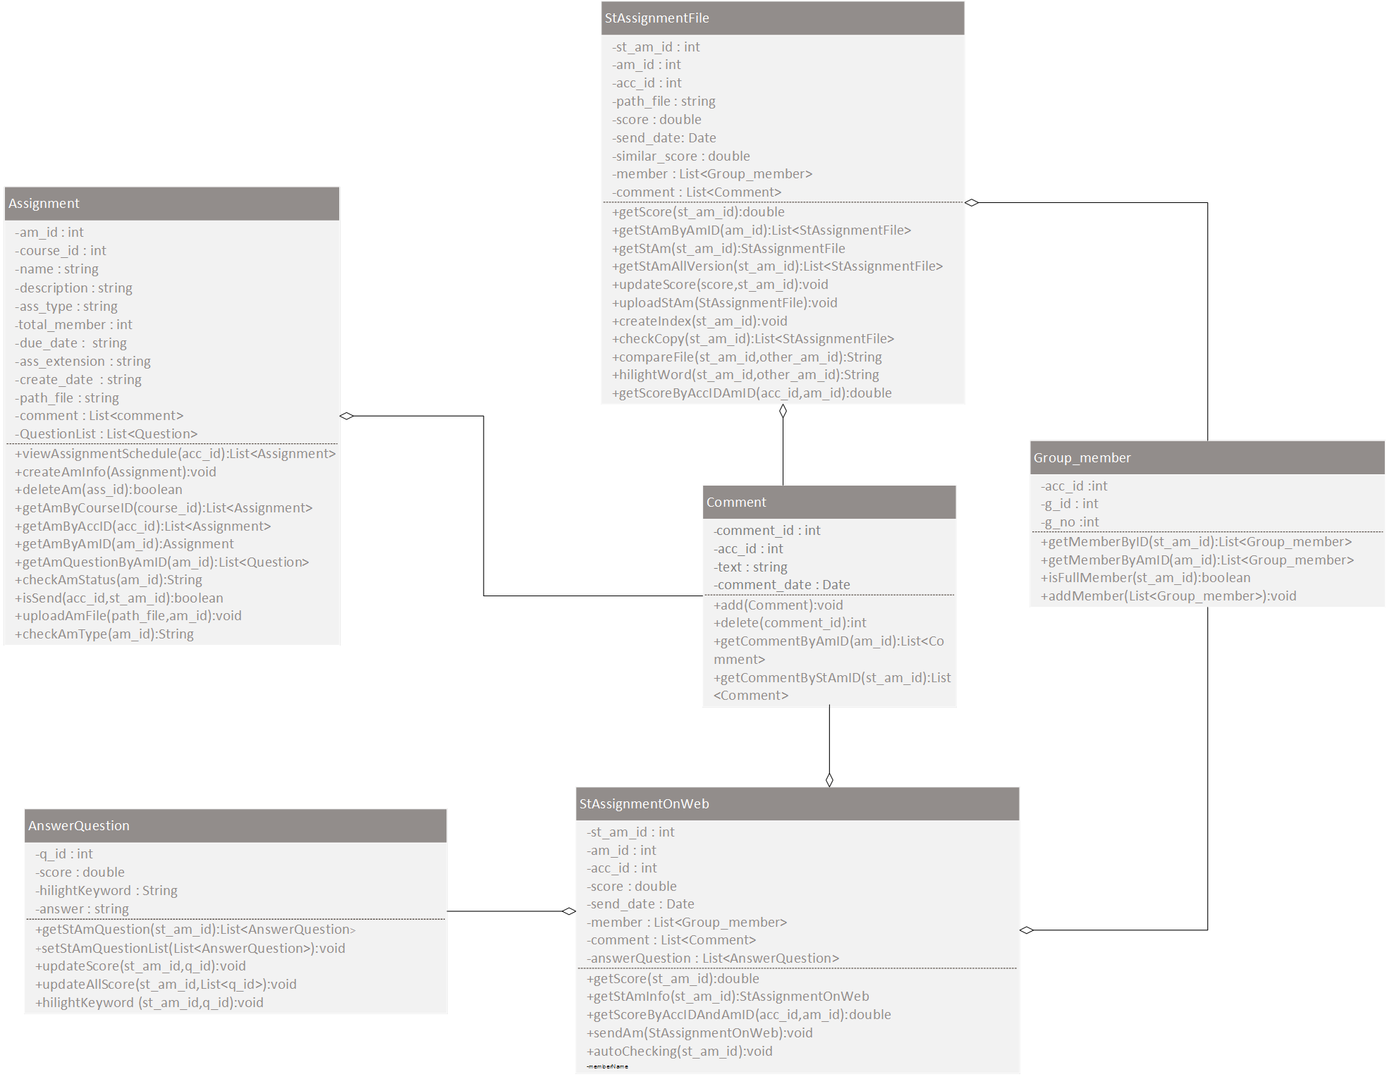
Class Diagram of StudentAssignment
Notes:
นอกจาก class assignment แล้ว จะมี class ที่เกี่ยวกับ Student assignment ซึ่งเอาไว้เก็บข้อมูลการบ้านที่นักเรียนแต่ละคนส่งมา โดยเราจะแบ่งเป็นสอง class คือ
Class StAssignmentFile เก็บข้อมูลการส่งการบ้านแบบไฟล์ของนักเรียนซึ่งจะประกอบไปด้วยที่อยู่ของไฟล์ รายชื่อสมาชิก และข้อมูลการแสดงความคิดเห็นการบนงาน
ต่อมาคือ Class StAssignmentOnWeb เก็บข้อมูลการบ้านที่ทำการบนเว็บซึ่งจะเก็บรายชื่อสมาชิก และชุดของคำตอบของนักเรียนไว้สำหรับรอตรวจคำตอบ
Besides assignment class, it has 2 types of class that related to student assignment.First, StAssignmentFile class. This is a class for keeping sent assignment details in type of files. The details have files directory , members and comments in assignments. Second, StAssignmentOnWeb class. This class keeps assignment details in type of doing on web. The details have members of assignments and groups of students answers that use to check score.

Slide 17
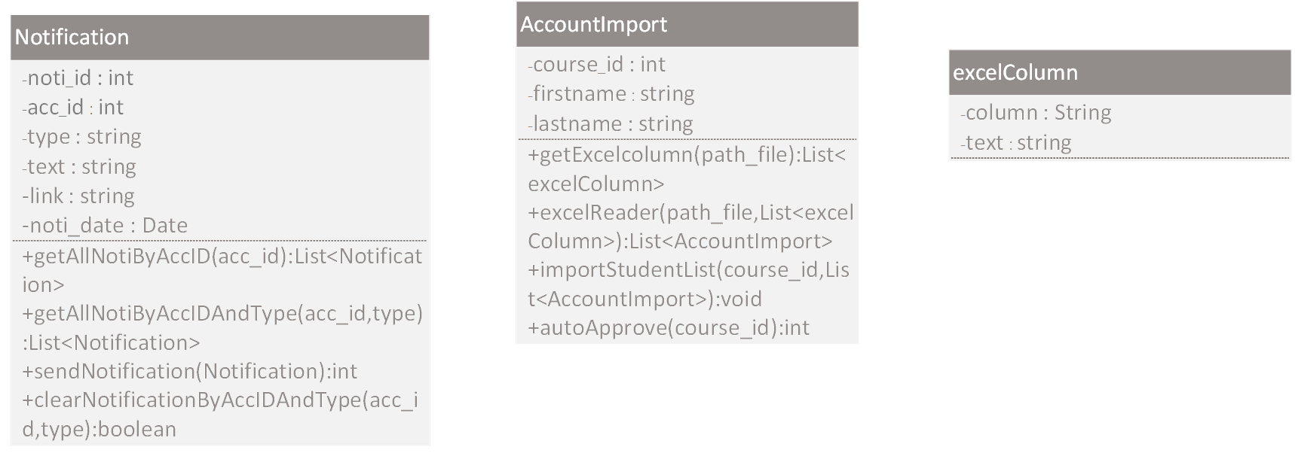
Others
Notes:
นอกจากนี้ยังมี class ที่เกี่ยวข้องอย่างอื่นคือ class notification สำหรับแจ้งเตือน class AccountImport สำหรับเก็บรายชื่อนักเรียนที่นำเข้าสู่ระบบเพื่อทำการ auto approve และ excelColumn ซึ่งเอาไว้เก็บค่าและคอลัมป์เวลาอ่านรายชื่อจาก excel ของนักเรียน
This page is a others class that related to our project, for example, notification class for notify many events , AccountImport class for keeping list of student names for auto approve students that request to join class and excelColumn Class for keeping column , rows and values for reading list of students from excel.

Slide 18
What in our presentation
Prototype & Mockup

Slide 19
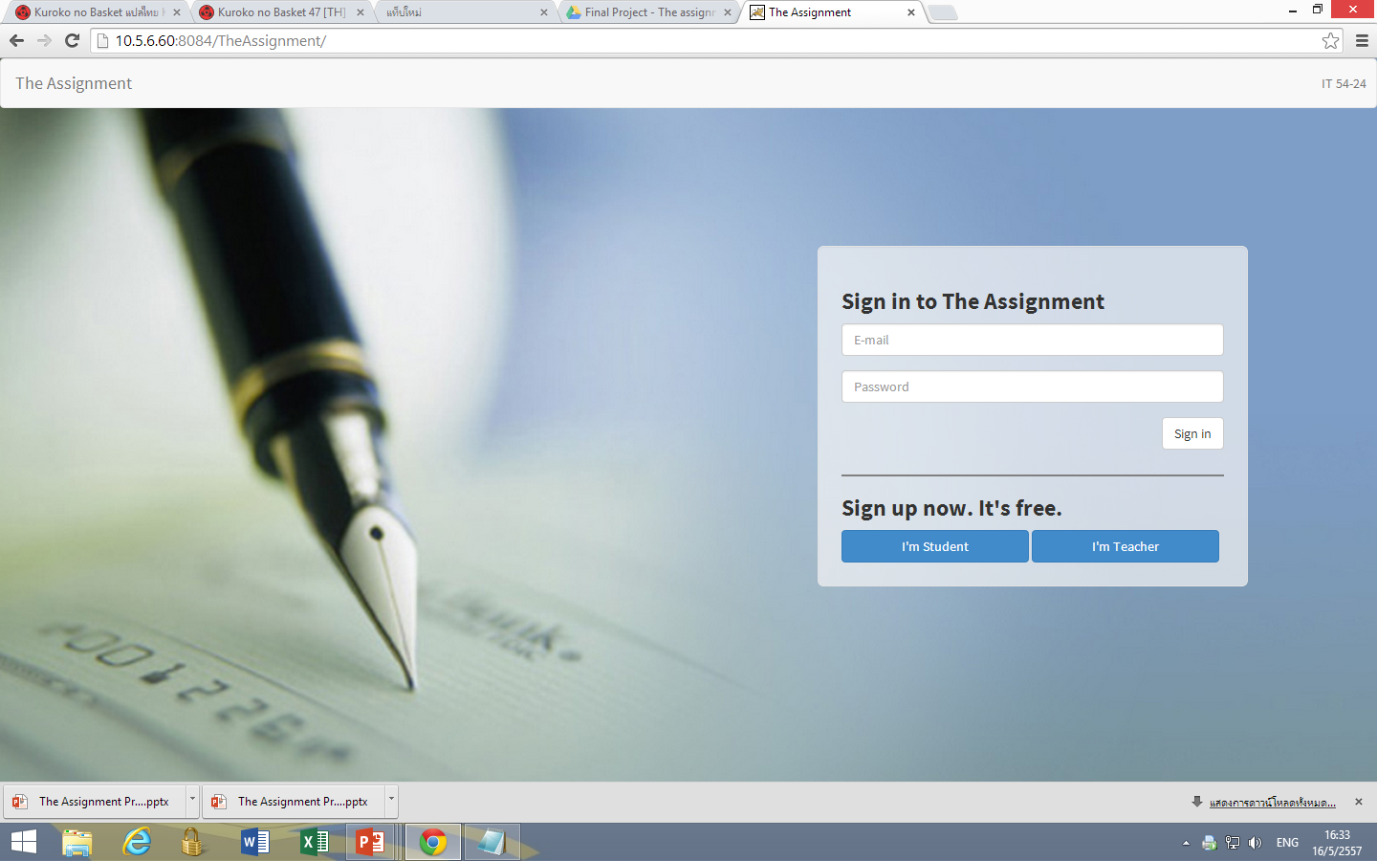
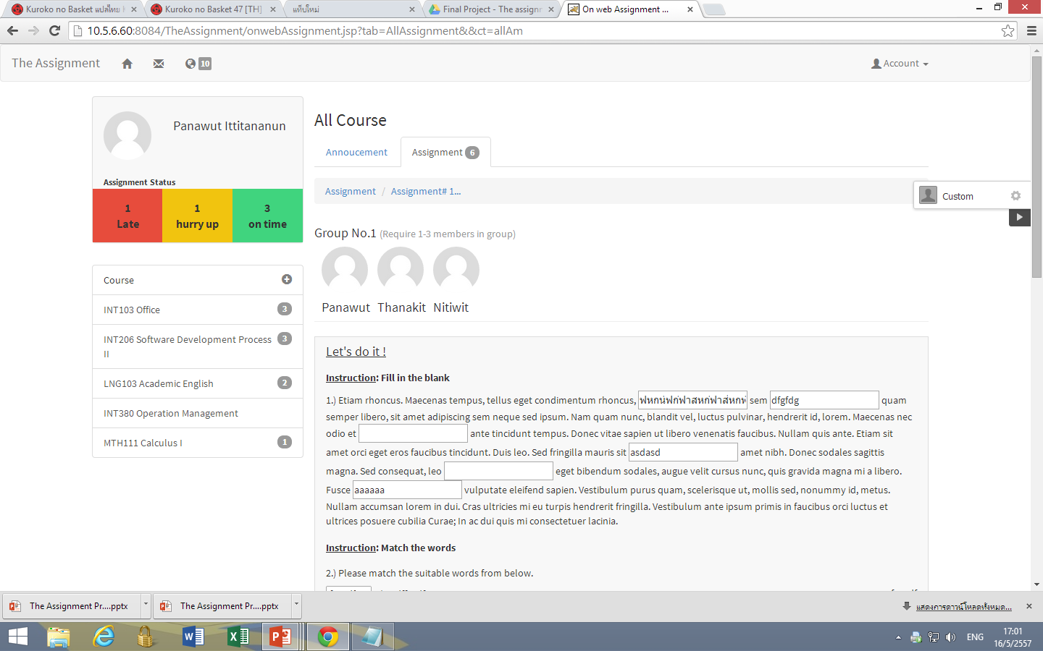
Web Application
Prototype

Slide 20
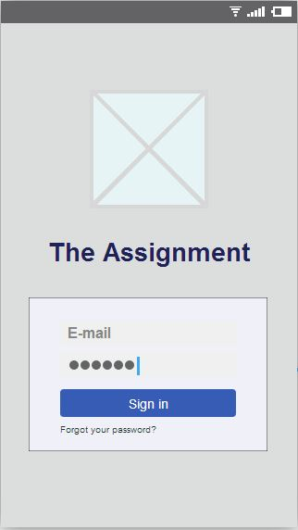
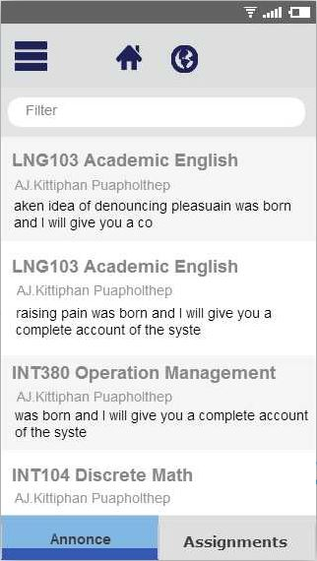
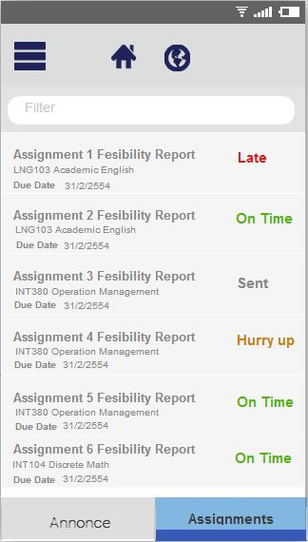
Mobile Application Mockup Student Side
Notes:
In the Mobile application The main function is to View. It can divide into Teacher and Student.
What to do *Follow by Mobile Use case diagram
In part of Student.
In the first page, Is the login page. Student to fill in the box as Email and Password.
After login Successful. It will go to the Home page. Which shows Annonce by default.
Every page will have Home icon for return to the All Annonce page
and Notification icon for view alerts such as new Assignment, Annouce and score.
In this page will show a Annouce of all course. The bottom of the page will have Assignment tab.
You can link to the page of the View All Assignment on this tab.
In View All Assignment page will show Assignment of all Course and status that the when of time to sent.
When you press one of the Assignment it will to show Assignment Detail page.

Slide 21
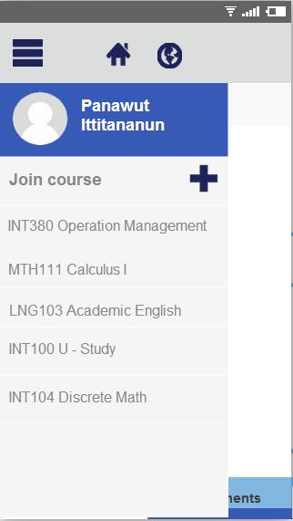
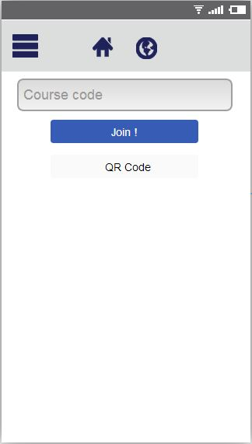
Mobile Application Mockup Student Side
Notes:
Next, when you press menu icon. You will meet Course in which you are members.
Can go to the Assignment and Annouce in course.
And Join course. when you press Join course. This page You can Enter code received from the teacher or QR Code to Join Course.

Slide 22
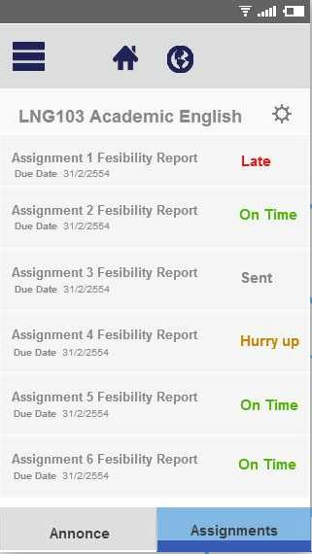
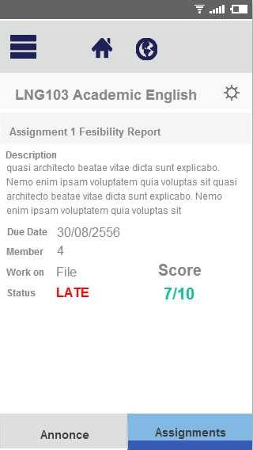
Mobile Application Mockup Student Side
Notes:
Next page is show Assignment in course. It will show status and due date of Assignment.
Student can leave course when you push a setting icon.
The last page is Assignment Detail page.

Slide 23
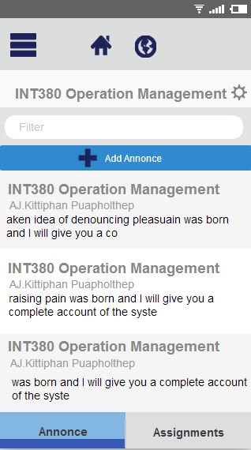
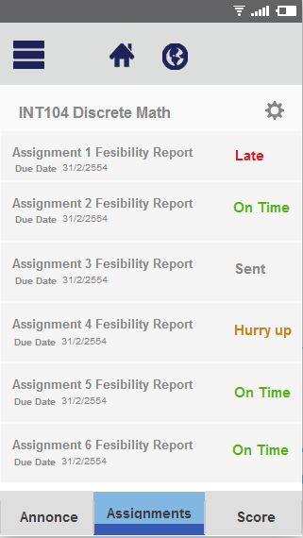
Mobile Application Mockup Teacher side
Notes:
Next, In past of Teacher
It similar to the Student in the page of login, All Annonce, All Assignment, Menu, Join course.
In the Annouce in course page have add annouce button.
When you push Assignment tab at the bottom. It will show Assignment in course page.
In the Assignment in course page. The bottom of the page will have Score tab.

Slide 24
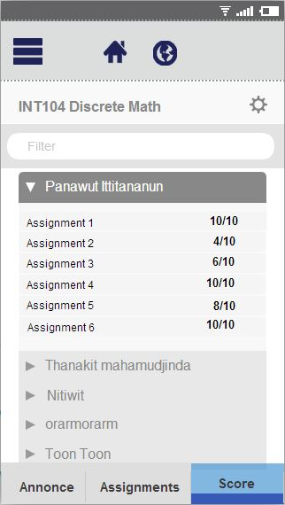
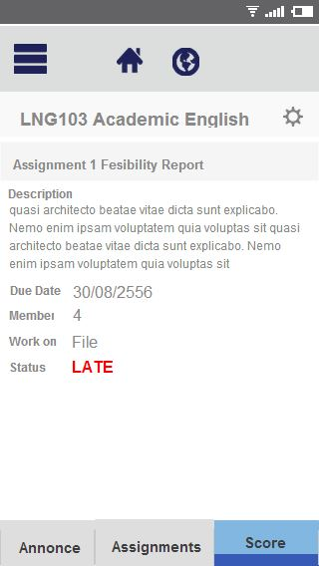
Mobile Application Mockup Teacher side
Notes:
In the Assignment in course page. The bottom of the page will have Score tab.
When you push Score tab at the bottom. It will show Score of all Student in course.
The last page. In Teacher view haven't received Score but it have Score tab to view score of all student.
Teacher can Edit name Course and Delete Course when you push a setting course.

Slide 25
Q & A
?
?

Slide 26
Thank you.

